Slide 1
SIGN LANGUAGE RECOGNITION
Group 22
Ahmed Mohammed Dabbous
Bhargava Bhamidipati
Devashish Singha Roy
Sofia Padovani Plazzi

Slide 2
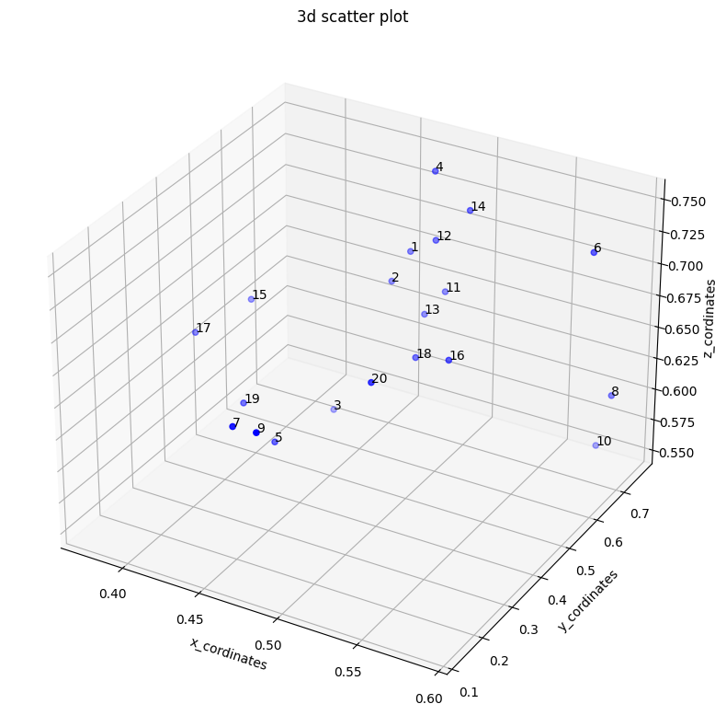
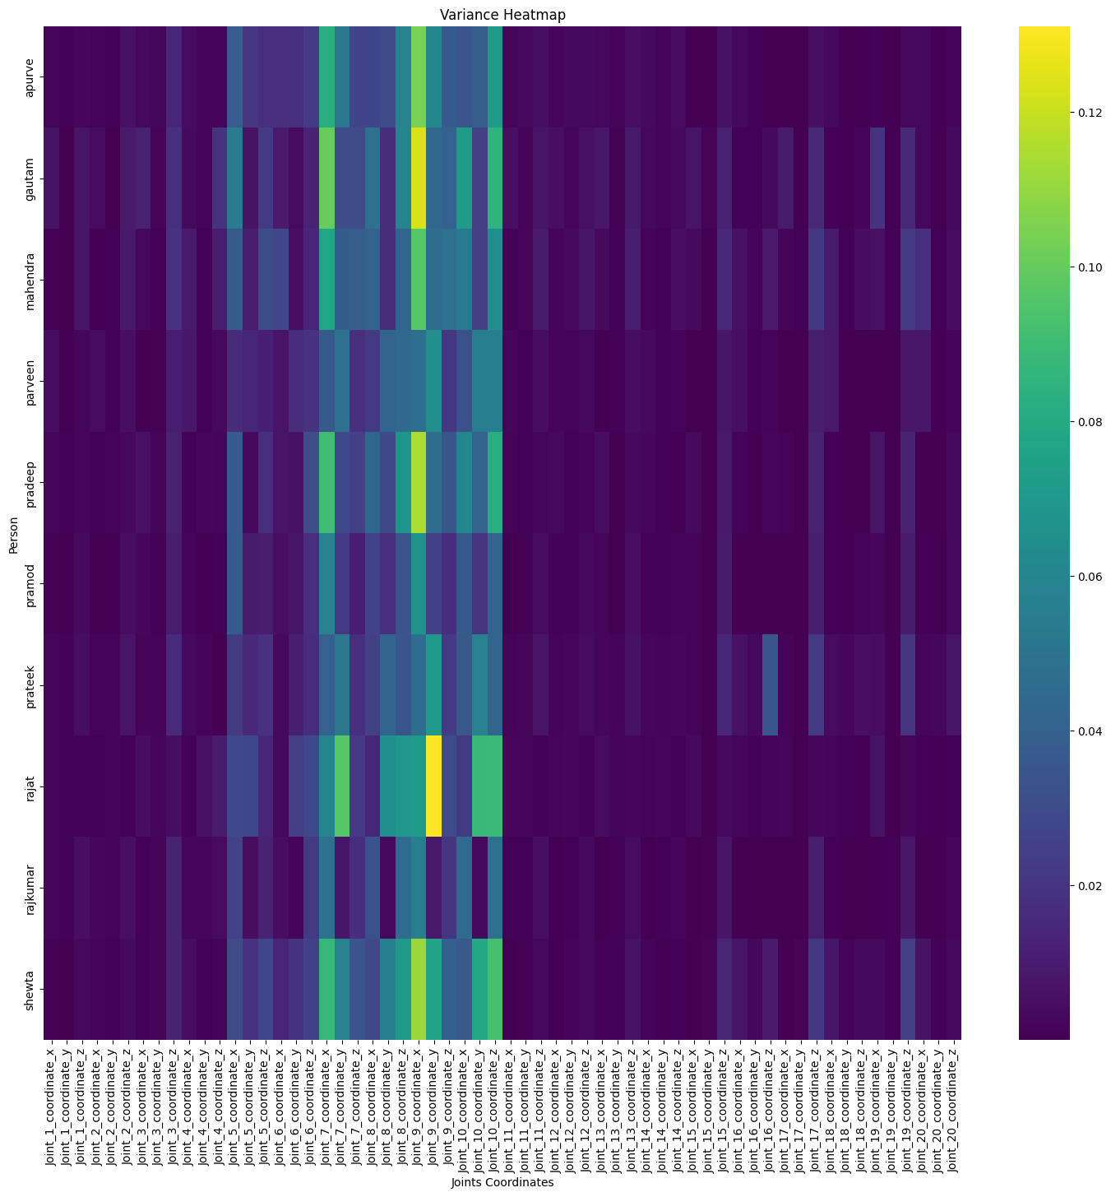
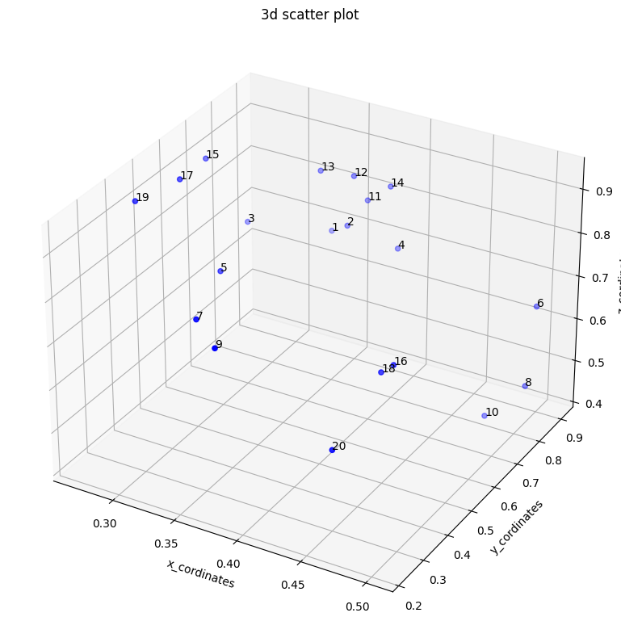
Some visualizations from Task 1
The data used in this project are sequential data as each sign is represented by multiple frames, following the movement of the body joints. Therefore, there are 60 values (20 joints x 3 coordinates) for each frame.
During data exploration, no missing data were found in the dataset.
We also visualized data in different ways in order to better understand the dataset itself and how to prepare it to be used during the training and testing of the models.
We visualized the correlation between joints and people for each sign to see which part of the body was the most important in performing the movements and how was changing between the signers. We also displayed the joints’ coordinates in a 3D space for each sign, observing data points changing.

Slide 3
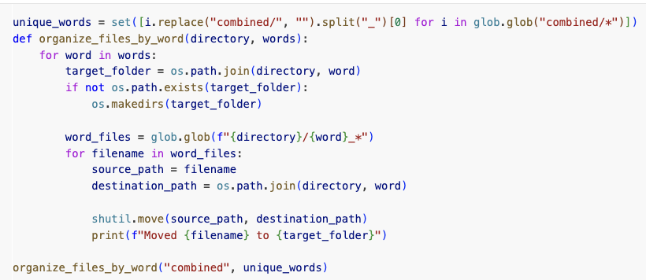
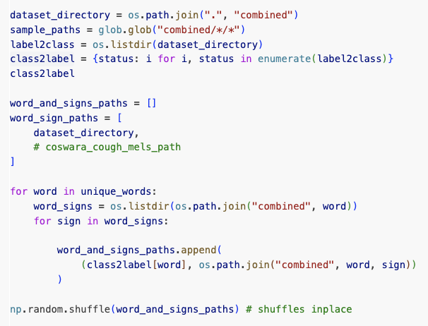
Data Preprocessing
FILE ORGANIZATION BY LABEL: The files are moved and organized based on the label (sign) (e.g., "yes" or "bye") in the filename by the organize_files_by_word function. (Figure 1)
LABEL ENCODING: The label2class dictionary maps each sign to a numerical label. Conversely, class2label maps labels back to the corresponding label. (Figure 2)
FILE PATH AND LABEL PAIRING: a tuple of (label, filepath) is created and stored in word_and_signs_paths for each file. The data is then shuffled randomly to ensure randomness during training. (Figure 2)
Figure 1
Figure 2

Slide 4
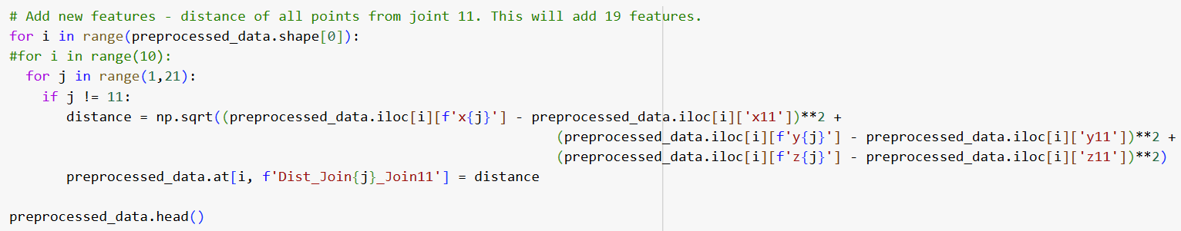
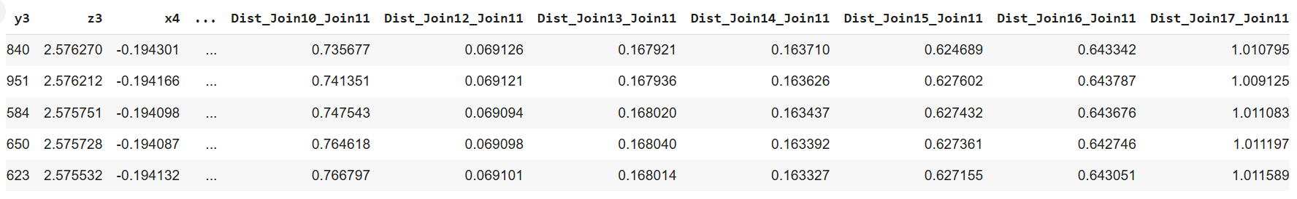
Data Preprocessing
NEW FEATURES: We calculated the distances between each joint to joint 11 (the central joint) in order to obtain new features with which train our model.
This method added 19 features to our dataset (Figure 3 & 4).
Figure 3
Figure 4

Slide 5
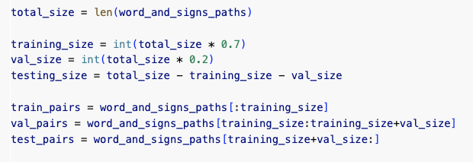
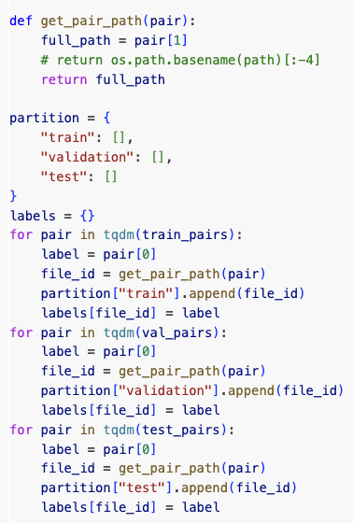
Data Preprocessing
DATASET SPLIT: The dataset is then split into training (70%), validation (20%), and testing (10%) sets. (Figure 5)
partition dictionary, with keys "train", "validation", and "test", stores the file paths for each dataset split.
Iteratively, the label and file_id (got it using the function get_pair_path in Figure 6) are extracted from the lists train_pairs, val_pairs, and test_pairs for each sample and, with file_id also appended to the appropriate split in the partition dictionary. Then an entry to labels for each file_id is added, mapping it to its label.
In this way, partition end up containing the paths for each dataset split, and while the list labels is a dictionary mapping every file_id to its label.
Finally, separate dictionaries are created for training (trn_labels), validation (val_labels), and testing (test_labels) by referencing partition. This is done to separate labels according to each dataset split.
Figure 5
Figure 6

Slide 6
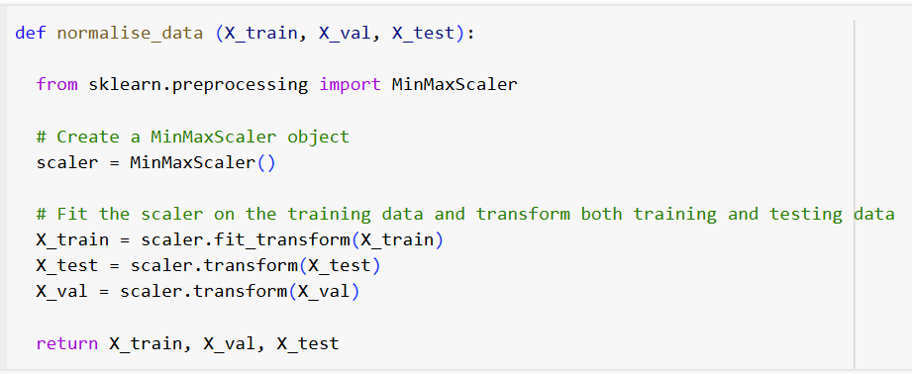
Data Preprocessing
NORMALIZATION:
MiniMaxScaler from sklearn is used for normalising the data. This makes the data to be in the range 0 to 1.
The scaler is fit on trained data and then used to transform train, test and validation data.
Note: Normalisation is done after the split of the data so as to prevent data leakage, i.e., avoiding information (min and max value) from the test set influencing the training process.
Figure 7

Slide 7
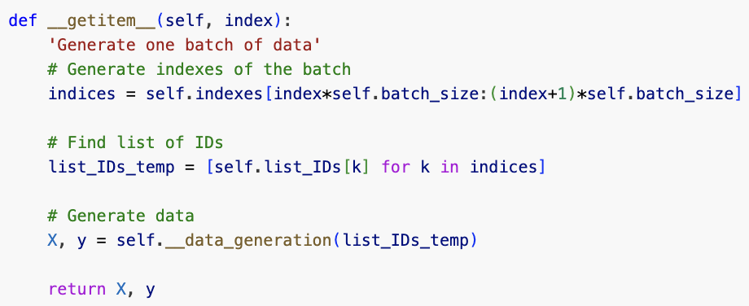
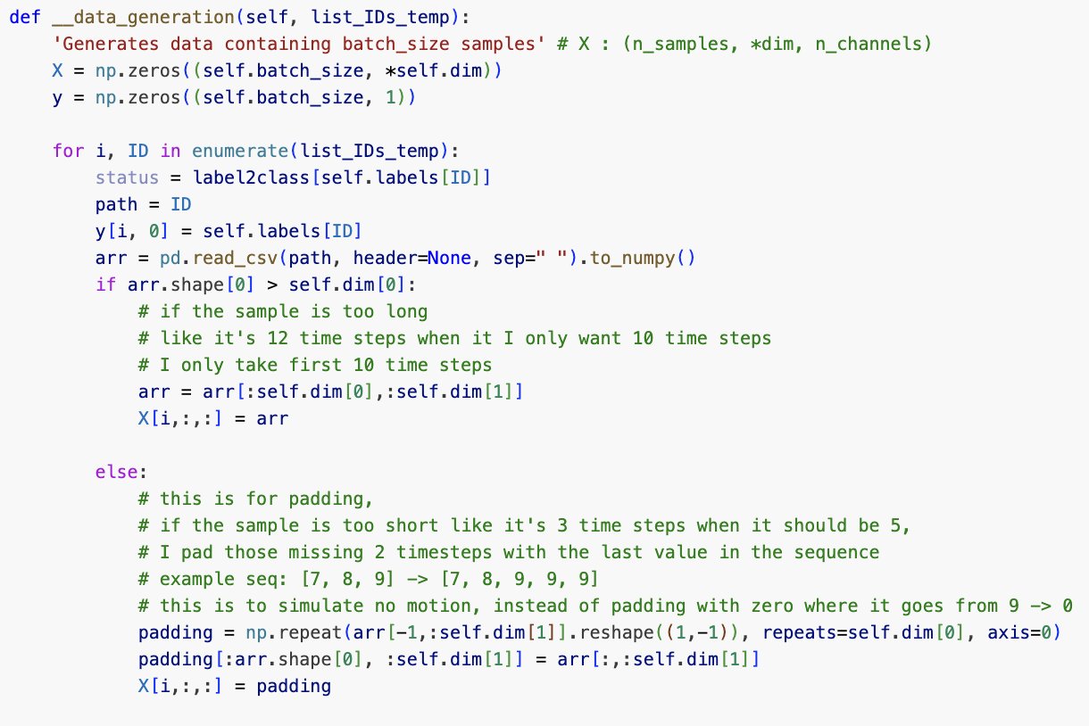

Data Preprocessing
DATASET GENERATION: Main methods of the class DataGenerator(keras.utils.PyDataset):
Batch Creation: the method extracts a list of IDs corresponding to the batch index, it calls __data_generation for padding and formatting, and finally returns a batch of features X and labels y (Figure 8).
Data Generation: Loads each file with pandas.read_csv and converts it to a NumPy array (Figure 9).
Trimming/Padding: If the sequence has more time steps than required, it’s trimmed to match dim[0] (200 timesteps). If shorter, it’s padded using the last time step (Figure 9).
Figure 8
Figure 9
Figure 10

Slide 8
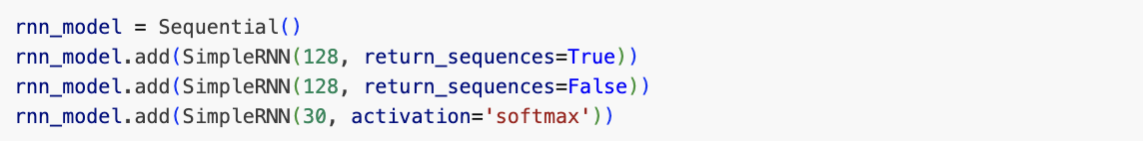
RNN
STRUCTURE: The model is built using Keras and consists of two SimpleRNN layers, one that retains full sequential outputs, and a following one that produces a single vector, and a Dense output layer with 30 units and softmax activation for multi-class classification.
ADVANTAGES:
Conceptual Simplicity: Simple to understand, consistents of a single hidden state that is maintained through recurrent connections
DISADVANTAGES:
Lack of long term dependencies due to the vanishing griadnt problem
Figure 11
Figure 12

Slide 9
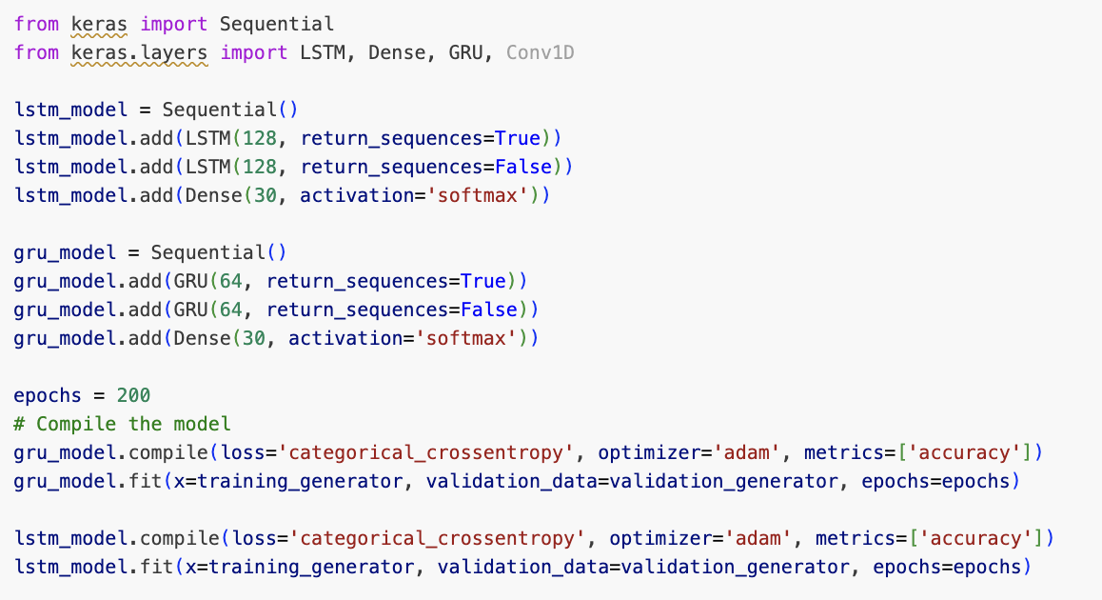
LSTM
STRUCTURE: The model is built using Keras and consists of two LSTM layers, one that retains full sequential outputs, and a following one that produces a single vector, and a Dense output layer with 30 units and softmax activation for multi-class classification.
ADVANTAGES:
Long-term dependencies: its ability to handle long-term dependencies make it effective in capturing complex gestures and patterns.
DISADVANTAGES:
Computational demanding: LSTM are more than RNN and GRU, which may be a problem in real-time applications.
Figure 13
Figure 14

Slide 10
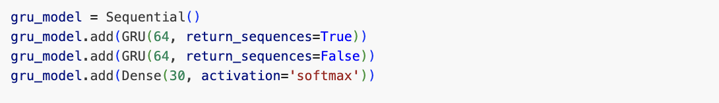
GRU
STRUCTURE: The model is built using Keras and consists of two GRU layers, one that retains full sequential outputs, and a following one that produces a single vector, and a Dense output layer with 30 units and softmax activation for multi-class classification.
ADVANTAGES:
Less Computational Demanding: GRU are faster and less complex than LSTM.
DISADVANTAGES:
Slow Convergence and Learning Rate
Lack of Internal Memory and Output Gate
Figure 15
Figure 16

Slide 11
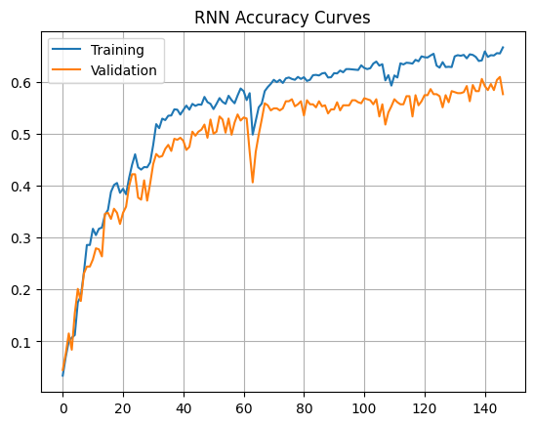
RNN - Results with Original Data
STRUCTURE: The model is built using Keras and consists of two SimpleRNN layers, one that retains full sequential outputs, and a following one that produces a single vector, and a Dense output layer with 30 units and softmax activation for multi-class classification.
ADVANTAGES:
Conceptual Simplicity: Simple to understand, consistents of a single hidden state that is maintained through recurrent connections
DISADVANTAGES:
Lack of long term dependencies due to the vanishing griadnt problem
Figure 17

Slide 12
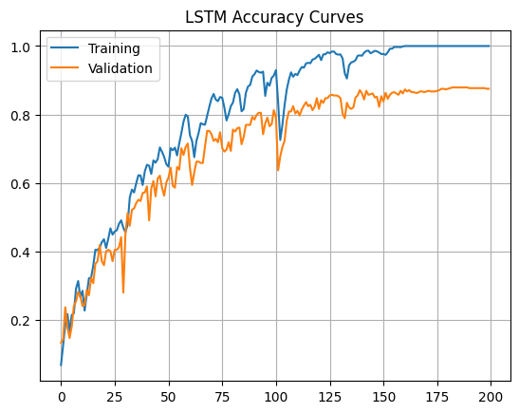
LSTM - Results with Original Data
LSTM Trained with Original Data
In figure 18, it can be noticed that accuracy of both training and validation overcome 80%. While the model began to slightly overfit on the valIdation dataset early on, we kept training the model given that both accuracies were increasing in tandem.
Figure 18

Slide 13
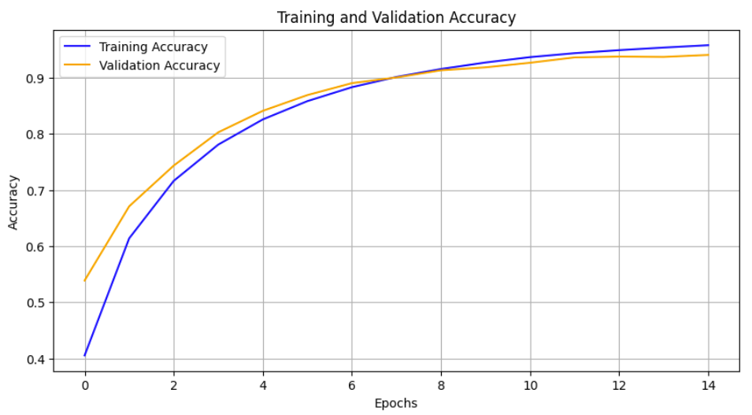
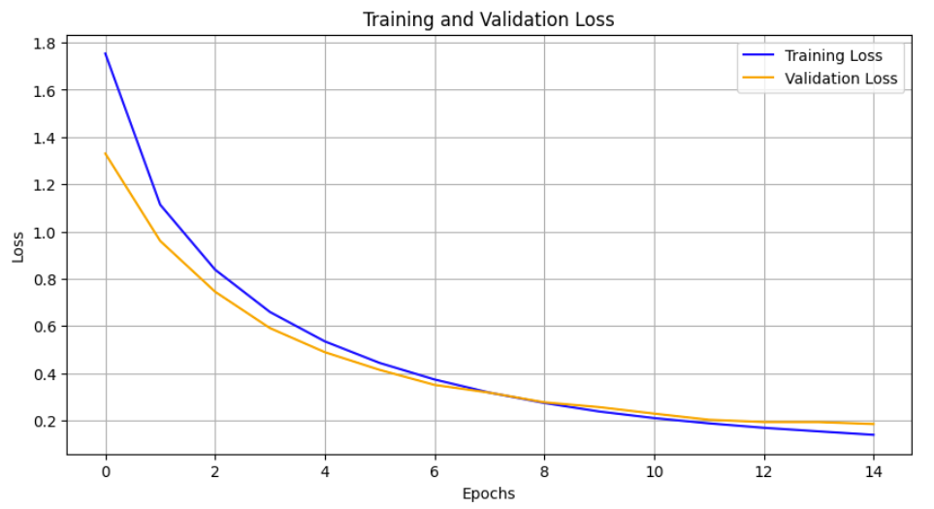
GRU - Results with Original Data
GRU Trained with Original Data
In figure 19, it can be noticed that accuracy of both training and validation set reach around 94-96%. While Loss progressively decrease in Figure 20. The model is slightly overfitting.
Figure 19
Figure 20

Slide 14
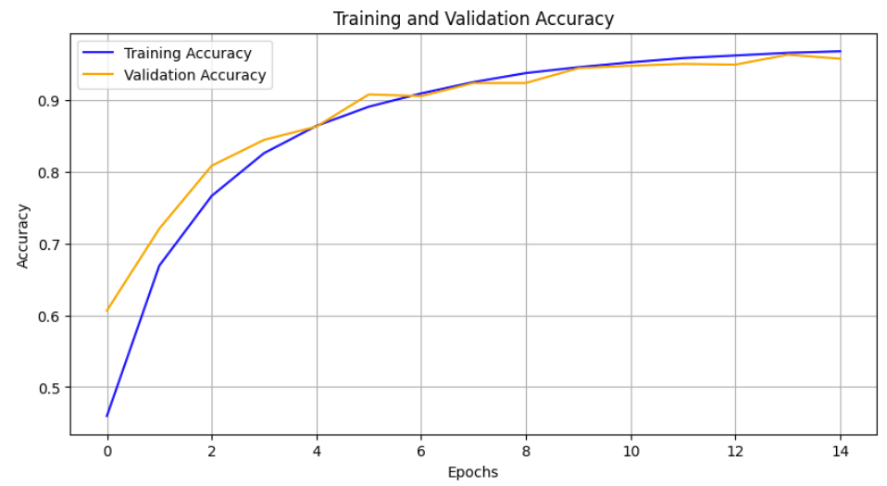
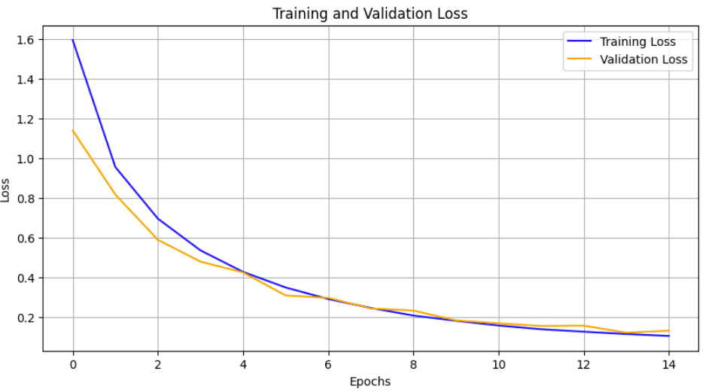
GRU - Results with Added features
GRU Trained with Added Features
In figure 21, it can be noticed that accuracy of both training and validation set reach around 95-97%. While Loss progressively decrease in Figure 22.
Figure 21
Figure 22

Slide 15
Discussion & Conclusion
Overall GRU performed the best. GRU was trained on original data and data with added features. With additional features, we get slightly higher accuracy (2% higher).
While RNN and LSTM have given accuracies 60.1% and 85.94% respectively.
 | RNN | LSTM | GRU Original Data | GRU Added Features
Testing Accuracy | 60.1% | 85.94% | 94.24% | 95.94%

